Slide 1
Containers and Software-Defined Servers
TidalScale
Faster Results – Lower Cost
Ike Nassi
O’Reilly Software Architecture Conference
2018-February
1

Slide 2
Current Use Cases
Simulation, Modeling & Graph Analysis
Retail Analytics
Business Intelligence
Data Science
Bioinformatics
Financial Analytics
9

Slide 3
Outline
What is a Software-Defined Server (SDS)?
How does it work?
Running Containers on SDS
Reliability of SDS
Performance of SDS
Managing SDS
Further Reading

Slide 4
Software-Defined Servers
Faster Results – Lower Cost
What is a Software Defined Server?
2

Slide 5
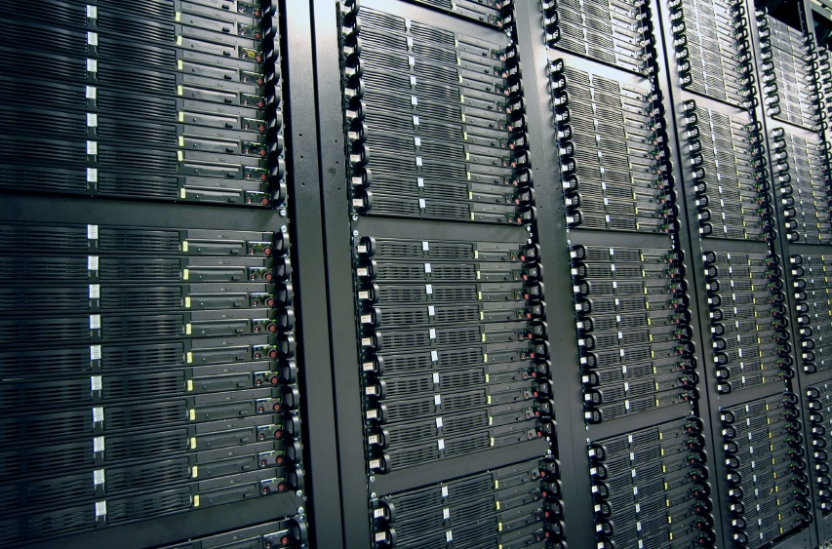
TidalScale: Software-Defined Servers
12 Cores | 128 GB | CentOS
48 Cores | 1 TB | SUSE
24 Cores | 1.5 TB | CentOS
Deploy in Minutes
32 Cores | 512 GB | Red Hat
16 Cores | 768 GB | CentOS
48 Cores | 12 TB | SUSE
Massively Scalable
48 Cores | 1 TB | Red Hat
32 Cores | 1 TB | CentOS
64 Cores | 4 TB | SUSE
Infinitely Configurable
96 Cores | 3 TB | SUSE
64 Cores | 1 TB | CemtOS
Software-Defined Server
96 Cores | 3 TB | SUSE
Build-as-you-grow
48 Cores | 1 TB | SUSE
64 Cores | 1 TB | CemtOS
Cloud or On-prem
96 Cores | 18 TB | SUSE
240 Cores | 15 TB | Red Hat
80 Cores | 2 TB | SUSE
Low Hardware Cost
240 Cores | 8 TB | SUSE
5
128 Cores | 6 TB | Red Hat
128 Cores | 6 TB | SUSE
Notes:
TidalScale uses virtualization but does it _across_ multiple physical servers, effectively allowing you to treat physical servers like lego building blocks.

Slide 6
Virtualization Today
Application
Discrete physical resources
One or more guest operating systems
Ideal for smaller applications and data sets
Not useful for large-
scale applications
Application
OS
Application
OS
vCPU
Application
OS
vCPU
OS
vCPU
vRAM
vCPU
vRAM
vRAM
vRAM
vRAM
vRAM
vRAM
Virtual
Resources
vRAM
CPU
CPU
RAM
CPU
RAM
CPU
RAM
RAM
RAM
RAM
RAM
Physical
Resources
RAM
Hypervisor
3

Slide 7
Software-Defined Servers The Future of Virtualization
Aggregated physical resources
Single guest operating system
No O/S or application modifications
Scale-up simplicity with scale-out size
Application Software
Application Software
vCPU
Operating System
Operating System
vCPU
RAM
vCPU
RAM
vCPU
RAM
RAM
RAM
RAM
RAM
Virtual
Resources
RAM
CPU
CPU
RAM
CPU
RAM
RAM
CPU
RAM
RAM
RAM
RAM
HyperKernel
Physical
Resources
RAM
HyperKernel
HyperKernel
Server 4
HyperKernel
Server 3
Server 2
Server 1
4

Slide 8
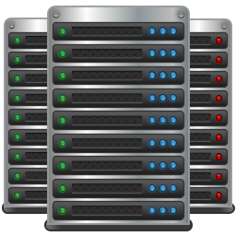
Applications and Data Center Utilization Pay-as-you-Grow
Evolution of a Software-Defined Server
Life of a Scale-up Server
Year 1
Year 2
Year 3
Requirements set before purchase
Sized for needs in18 to 36 month
Typically a ‘non-standard’ SKU for IT
SKUs may vary by workload
Grow capabilities with demand
Pay licenses for what you need, today
Built on commodity server SKUs
Fewer SKUs adaptable to workloads
7

Slide 9
TidalScale: Software-Defined Servers
Unmodified Software
Applications
Build-as-you-grow
Container Friendly
Operating Systems
Red Hat Certified
6
Notes:
TidalScale uses virtualization but does it _across_ multiple physical servers, effectively allowing you to treat physical servers like lego building blocks.

Slide 10
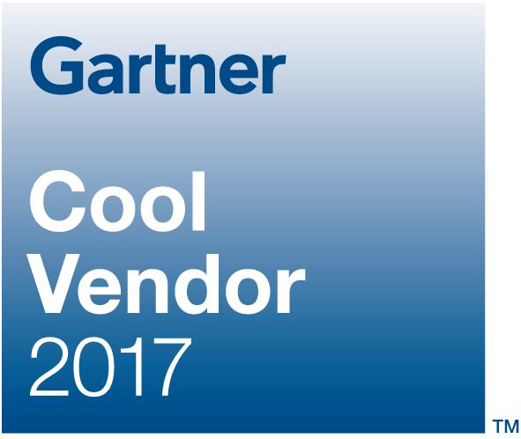
Strong Industry Momentum
Partners & Customers
Recognition
“TidalScale may have come up with the biggest advance in servers since VMware 18 years ago.”
“This is the way all servers will be built in the future”
Gordon Bell, industry legend and 1st investor in TidalScale
8

Slide 11
How does it work?

Slide 12
Machine Learning-Driven Self Optimization
Patented Algorithm:
Maps virtual resources to physical infrastructure
Load balances resources dynamically at runtime
Transparently migrates vCPUs and memory
Application Software
Application Software
vCPU
Operating System
Operating System
vCPU
RAM
vCPU
RAM
vCPU
RAM
RAM
RAM
RAM
RAM
Virtual
Resources
RAM
CPU
CPU
RAM
CPU
RAM
RAM
CPU
RAM
RAM
RAM
RAM
HyperKernel
Physical
Resources
RAM
HyperKernel
HyperKernel
HyperKernel
11
Notes:
Under the covers, TidalScale uses machine learning to automatically co-locate compute entity with the resources it needs. And just like ordinary virtualization it does all of this transparently - the OS and applications have no idea they aren't running on hardware....

Slide 13
Machine Learning-Driven Self Optimization
Memory Page Migration
Patented Algorithm:
Maps virtual resources to physical infrastructure
Load balances resources dynamically at runtime
Transparently migrates vCPUs and memory
Application Software
vCPU
Operating System
vCPU
RAM
vCPU
RAM
vCPU
RAM
RAM
RAM
RAM
RAM
Virtual
Resources
RAM
CPU
CPU
RAM
CPU
RAM
RAM
CPU
RAM
RAM
RAM
RAM
HyperKernel
Physical
Resources
RAM
HyperKernel
HyperKernel
HyperKernel
12
Notes:
Under the covers, TidalScale uses machine learning to automatically co-locate compute entity with the resources it needs. And just like ordinary virtualization it does all of this transparently - the OS and applications have no idea they aren't running on hardware....

Slide 14
Machine Learning-Driven Self Optimization
Virtual CPU Migration
Patented Algorithm:
Maps virtual resources to physical infrastructure
Load balances resources dynamically at runtime
Transparently migrates vCPUs and memory
Application Software
vCPU
Operating System
vCPU
RAM
vCPU
RAM
vCPU
RAM
RAM
RAM
RAM
RAM
Virtual
Resources
RAM
CPU
CPU
RAM
CPU
RAM
RAM
CPU
RAM
RAM
RAM
RAM
HyperKernel
Physical
Resources
RAM
HyperKernel
HyperKernel
HyperKernel
13
Notes:
Under the covers, TidalScale uses machine learning to automatically co-locate compute entity with the resources it needs. And just like ordinary virtualization it does all of this transparently - the OS and applications have no idea they aren't running on hardware....

Slide 15
Containers
14

Slide 16
Container Management Challenges Overloaded Servers
Server Limitations
Memory capacity
Memory bandwidth
Compute
Container 3
Container 2
Container 1
Container 0
Now What?
CPU
RAM
I/O
Server 0
Compute
I/O
Memory
15

Slide 17
Container Management Challenges Overloaded Servers
Migration is Difficult
Remote filesystem access
Changing pathnames
Network connections
Access control
Container 3
Container 2
Container 1
Container 0
CPU
RAM
CPU
I/O
RAM
Server 1
I/O
Server 0
TCP/IP Traffic
16

Slide 18
Container Migration Challenges
Heavy TCP/IP traffic
Difficult to manage
Lower Performance
Container 3
Container 2
Container 1
Container 0
CPU
RAM
CPU
I/O
RAM
Server 1
I/O
Server 0
TCP/IP Traffic
17

Slide 19
Containers on Software-Defined Servers
Container 3
Container 2
Container 1
Container 0
vCPU
vCPU
RAM
vCPU
RAM
vCPU
I/O
Now What?
RAM
I/O
Expand the Server
RAM
I/O
Virtual
Resources
I/O
CPU
CPU
RAM
CPU
RAM
I/O
CPU
RAM
I/O
RAM
HyperKernel
Compute
I/O
Memory
I/O
HyperKernel
Compute
I/O
Memory
Physical
Resources
I/O
HyperKernel
HyperKernel
18

Slide 20
Containers on Software-Defined Servers
Container 3
Container 2
The server adapts to the need
Add resources with no reboot
Manually or automated
Simplified management
Faster communication
Container 1
Container 0
vCPU
vCPU
RAM
vCPU
RAM
vCPU
I/O
RAM
I/O
RAM
I/O
Virtual
Resources
I/O
CPU
CPU
RAM
CPU
RAM
I/O
CPU
RAM
I/O
RAM
I/O
HyperKernel
Compute
I/O
Memory
HyperKernel
Compute
I/O
Memory
Physical
Resources
I/O
HyperKernel
HyperKernel
19

Slide 21
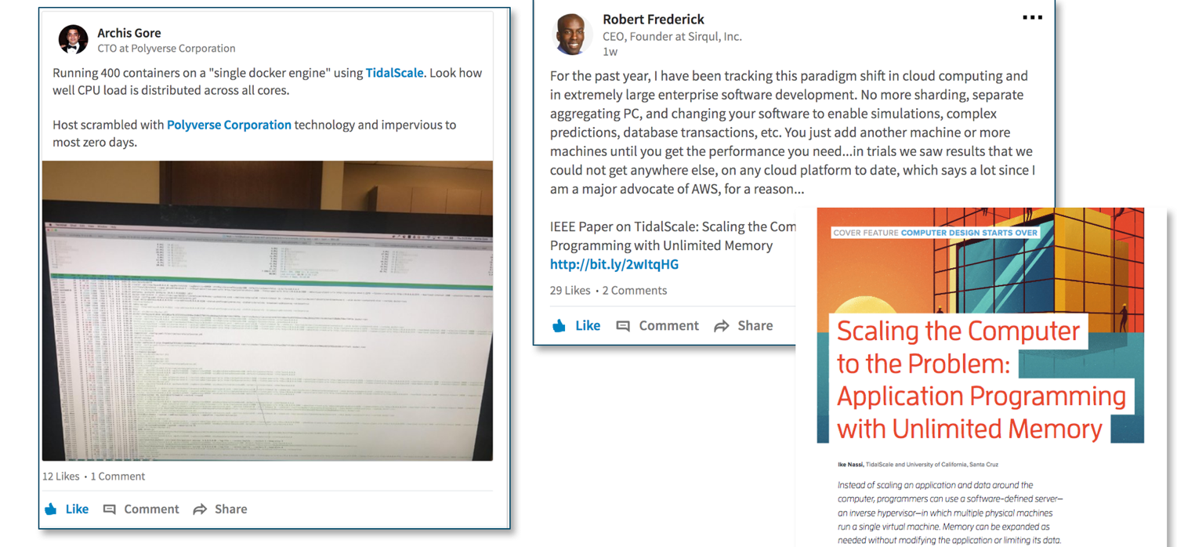
Examples from Industry
@ IBM:
20 servers,
15TB
400 cores
1 instance Centos
20

Slide 22
Software-Defined Servers
Faster Results – Lower Cost
Reliability
2

Slide 23
Low Mean Time to Repair Transparent Upgrades / Fixes with TidalScale
Identifying Failures with Telemetry Data
Bring spare online
Quarantine the failing server
Evict active processors from failing server
Evict active memory from failing server
Repair
Migrate
Failing
Spare
Fix failed server
Spare
Bring repaired server online as a spare
“TidalScale will make all components in a Server Hot Swappable”
Fred Weber, former CTO AMD
21
2121

Slide 24
Performance
22

Slide 25
Faster Results Retail Analytics Use Case – TPC-H
TPC-H Powertest
100
Amazon EC2
90
TidalScale Software-Defined Server
80
69.1
70
TEST FAILS
60
50
Minutes to Process
40
30
In-Memory Performance:
3x faster at 550 GB
Infinitely faster at 800 GB
33.7
20
22.0
10
0
0
100
200
300
400
500
600
700
800
900
1,000
Workload Size (GB)
23
Notes:
That retail analytic customer that I mentioned earlier: We were able to demonstrate scalable in-memory performance running TPC-C Power test on their analytics database. Compare that to AWS EC2 where the same workload dies when it hits the memory cliff.

Slide 26
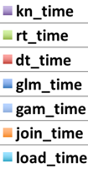
Faster Results R Predictive Analytics Use Case
952 min
845 min
730 min
Within 23%
of 4 Socket
Within 13%
of 4 Socket
Elapsed Time
Scale-up
AWS X1.32xlarge
4-Socket / 2TB
TidalScale
2-Socket (x2)
v1.2.2
TidalScale
2-Socket (x2)
v2.0 RC3
24

Slide 27
Software-Defined Servers
Faster Results – Lower Cost
Managing
25

Slide 28
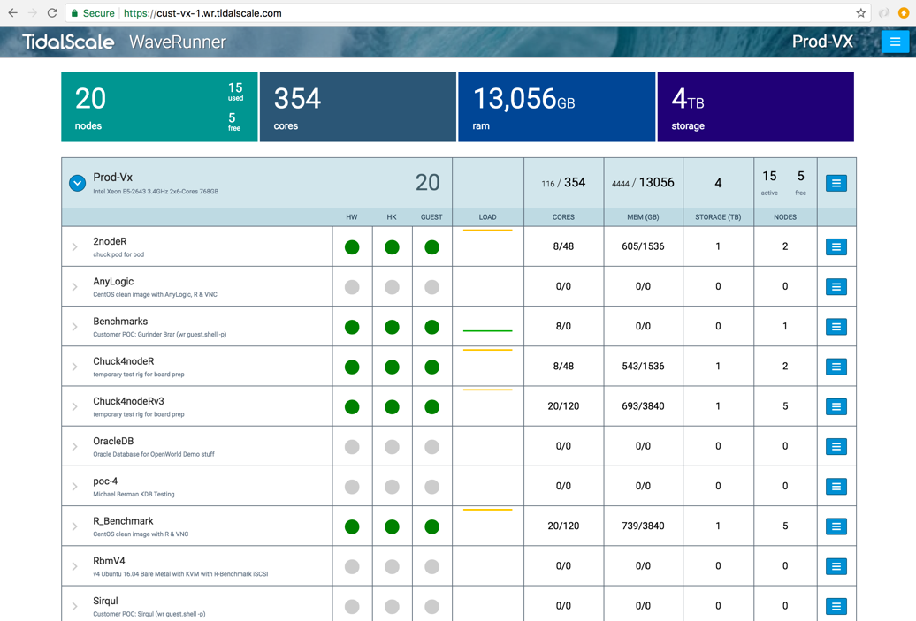
WaveRunner: Deploy in Minutes
Available Nodes
Create TidalPod
25

Slide 29
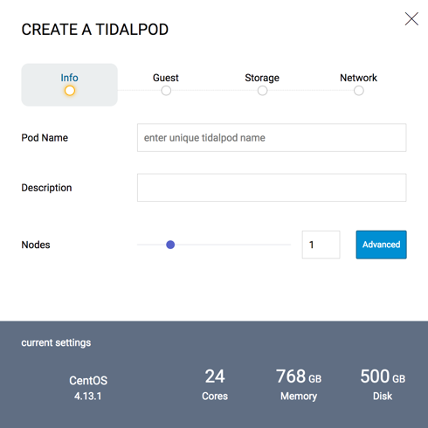
WaveRunner: Deploy in Minutes
EASY
Enter Name
Name Your Software Defined Server
26

Slide 30
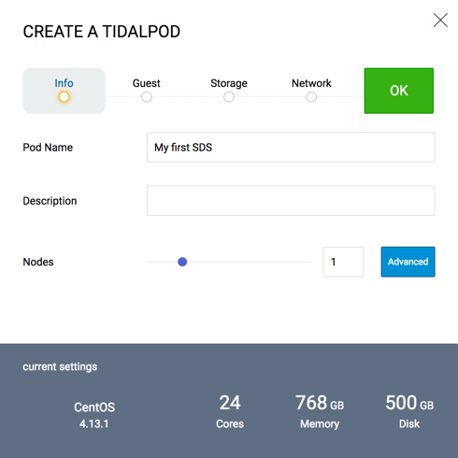
WaveRunner: Deploy in Minutes
EASY
Enter Name
Check Settings
EASY
Enter Name
Check Settings
27

Slide 31
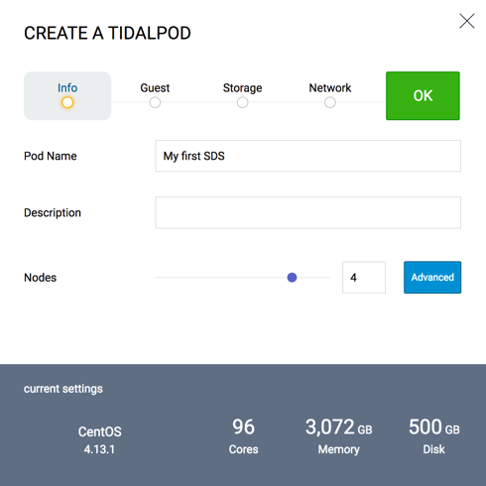
WaveRunner: Deploy in Minutes
EASY
Enter Name
Check Settings
Click OK
EASY
Enter Name
Check Settings
Click OK
Adjust the Slider
New Settings
28

Slide 32
WaveRunner: Deploy in Minutes
Deployed Server
29

Slide 33
Saves Development and Deployment $$
If you are writing new applications:
Build, test, deploy on a single Linux server
As it grows, modify the server not the app!
Run in the cloud, or deploy on-prem
If you are running a legacy application:
Size the server you need to the current requirement
Run it on TidalScale, and let TidalScale manage scaling (up or down)
Save $$ by only using what you need, when you need it
On-prem or cloud
If you are running a licensed app:
Size the server appropriate to the needs of the app
License the SW only for what you need, when you need it
30

Slide 34
For Further Reading
Blogs:
Why Two Tech Legends Changed Their Minds About the Future of Computers
Containers and Software-Defined Servers: A Win-Win
Articles:
Revisiting Scalable Coherent Shared Memory (IEEE Computer 2018-01)
Scaling the Computer to the Problem: Application Programming with Unlimited Memory (IEEE Computer 2017-08)
Website:
www.TidalScale.com
31

Slide 35
Thank You
ike.nassi@tidalscale.com
Notes:
TidalScale Software-Defined Servers are a game changer! They let you explore your data more easily, improve your results and allow you spend more time doing data science instead of data plumbing all while lowering your operational TCO and increasing IT flexibility. This is why one of our early investor's said it best: "This is the way all servers will be built in the future."

